Slide 1
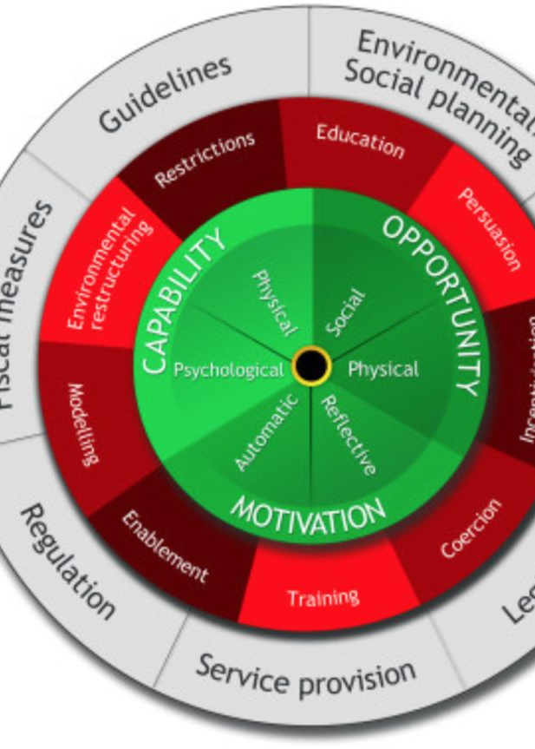
Behaviour Change Approaches:
CBT and BCT
Module: PT5050
Lubna Syed

Slide 2


Learning Outcomes
Define
Define what Behaviour Change Approaches (BCAs) are.
Explain
Explain why behaviour change is important in physiotherapy practice.
Describe
Describe key Behaviour Change Theories and the Behaviour Change Wheel.
Identify
Identify Behaviour Change Techniques (BCTs) and their categories.
Apply
Apply BCTs to clinical scenarios to enhance patient motivation and adherence.

Slide 3
What Are Behaviour Change Approaches (BCAs)?
Systematic methods for influencing how people think, feel, and act to promote healthier behaviours.
Drawn from psychology, behavioural science, and health promotion.
Include education, motivation, and skill-building interventions.

Slide 4

Why Do We Need Behaviour Change Approaches?
Physiotherapy often requires patients to change behaviour (exercise, posture, pacing, adherence).
Non-adherence rates up to 50%.
Behaviour determines long-term health outcomes more than knowledge alone.

Slide 5





Theoretical Foundations
Self-Efficacy Theory
Theory of Planned Behaviour
Health Belief Model (HBM)
Social Cognitive Theory
Self-Determination Theory (SDT)
Social Norms Theory
Transtheoretical Model (Stages of Change)
COM-B Model – Capability, Opportunity, Motivation → Behaviour.

Slide 6

Theoretical Foundations
Self-Efficacy Theory
Proposed by Albert Bandura,
This theory suggests that an individual’s belief in their capability to execute behaviours necessary to produce specific performance attainments is crucial for behaviour change.
Theory of Planned Behaviour
This theory suggests that intention is the primary predictor of behaviour,
attitudes toward the behaviour,
subjective norms, and perceived behavioural control.

Slide 7
Theoretical Foundations
Transtheoretical Model (Stages of Change)
behaviour change as a process that occurs in stages
precontemplation,
contemplation,
preparation,
action,
maintenance
Health Belief Model (HBM)
The model suggests that health-related behaviours are influenced by a person’s perceptions of the threat posed by a health problem.

Slide 8
Theoretical Foundations
Self-Determination Theory (SDT)
SDT focuses on motivation behind choices people make without external influence and interference.
Social Norms Theory
what is considered normal or acceptable within their social group.
Social Cognitive Theory
Also developed by Bandura,
this theory emphasizes the role of observational learning,
imitation, and modeling in behaviour change.

Slide 9

The Importance of Theory in Behaviour Change Approaches
They are crucial in the fields of psychology, health promotion, and public health because they provide structured methods for influencing behaviour.
Role of Theories in Guiding BCT Selection
Theories provide a comprehensive understanding of the mechanisms underlying behaviour change.

Slide 10

The Importance of Theory
Alignment with Specific Behaviours and Populations
Theories also assist in aligning BCTs with specific behaviours and target populations.
Evaluation and Adaptation of Interventions
aids in the initial design of interventions, also plays a critical role in their evaluation and adaptation over time.

Slide 11
Introducing CBT
Definition of CBT
Developed by Aaron Beck and Albert Ellis
Core idea: our thoughts influence feelings and behaviour

Slide 12
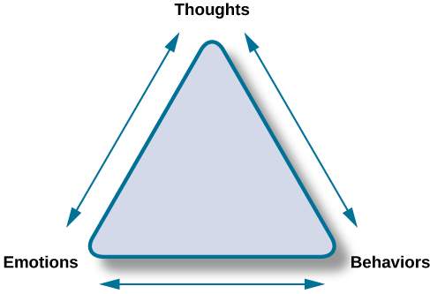
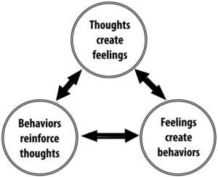
The CBT Model (Cognitive Triangle)

Slide 13
Key Principles of CBT
Collaborative, structured, goal-oriented
Present-focused and time-limited
Emphasis on identifying and restructuring unhelpful thoughts

Slide 14
All-or-nothing thinking
Catastrophising
Overgeneralising
“Should” statements
Cognitive Distortions (Unhelpful Thinking Styles)

Slide 15

Applying CBT in Physiotherapy Practice
Addressing fear-avoidance beliefs
Promoting self-efficacy
Supporting adherence to exercise programmes
Integrating CBT principles during patient education

Slide 16
Socratic questioning (“What evidence supports that thought?”)
Guided discovery
Behavioural experiments (“Let’s test that assumption safely.”)
Goal setting and self-monitoring
CBT Techniques in Clinical Conversations

Slide 17
Scope of physiotherapist practice (CBT-informed vs full CBT)
Need for training and supervision
Referral to psychological services when appropriate
Limitations and Considerations

Slide 18
Evidence Base for CBT in Physiotherapy
Key findings from literature:
  CBT reduces pain-related fear and disability
  Improves adherence and psychological coping
  NICE recommends CBT for chronic pain, fatigue, and anxiety/depression

Slide 19
Patient:
45-year-old with chronic low back pain, fearful of movement
Task:
Identify thoughts, feelings, behaviours, and possible CBT interventions
Case Example

Slide 20
COM-B Model Explained
Core of the Behaviour Change Wheel (Michie et al., 2011).
Behaviour occurs when Capability, Opportunity, and Motivation interact.
Physiotherapy example:
Capability: patient knows how to do exercises
Opportunity: has time and space at home
Motivation: believes it’s beneficial

Slide 21
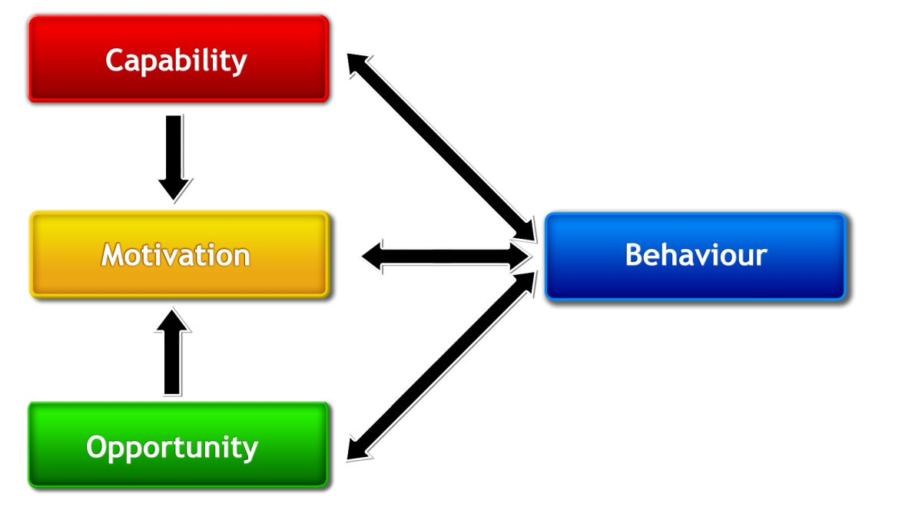
The COM-B Model Approach

Slide 22

The Behaviour Change Wheel
Framework linking:
  Sources of behaviour (COM-B)
  Intervention functions (e.g., education, persuasion, training)
  Policy categories (e.g., guidelines, regulation)
Physiotherapists mainly work at intervention level.

Slide 23
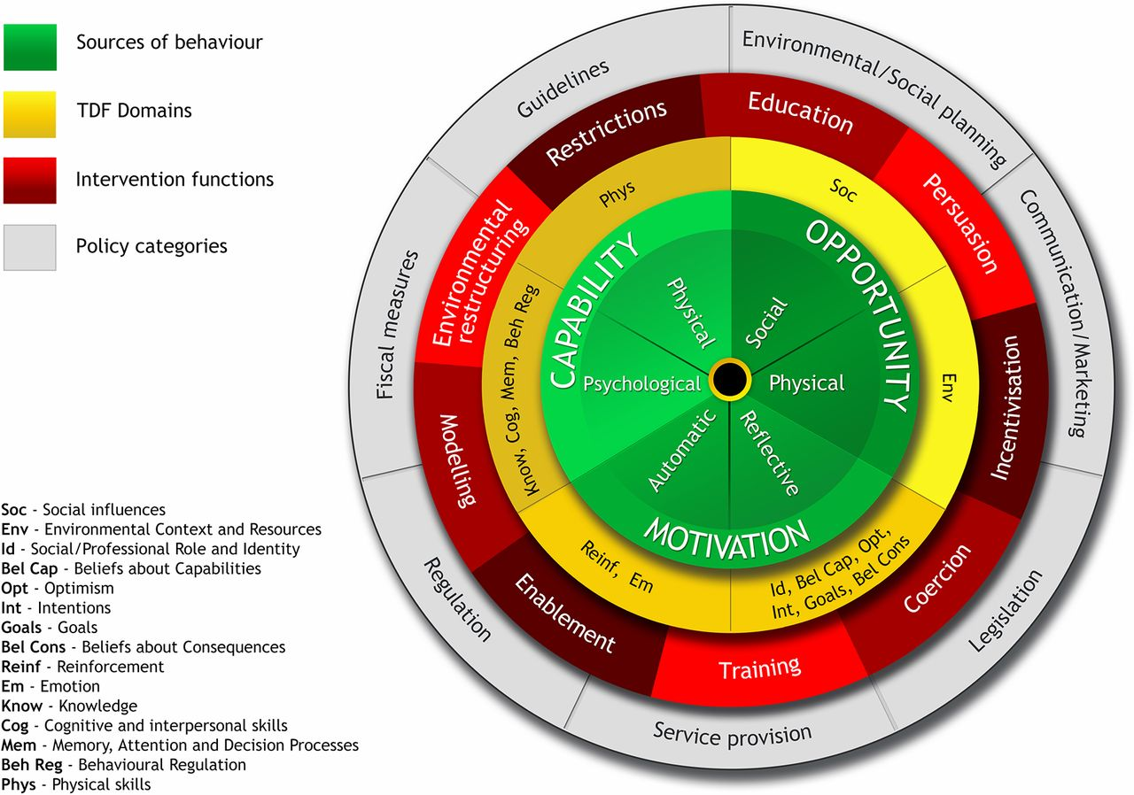

Slide 24




What Are Behaviour Change Techniques (BCTs)?
Definition: “Active ingredients” of interventions that bring about behaviour change.
Small, observable, replicable components (Michie et al., 2013).
Over 93 identified BCTs (BCT Taxonomy v1).

Slide 25
Category | Example BCT | Physio Example
Goal Setting | Set exercise goal | “Do 3 sets of 10 reps daily”
Self-Monitoring | Record exercises | Exercise diary or app
Feedback | Give positive feedback | “You’ve improved your balance since last week!”
Instruction | Demonstrate correct technique | Model proper posture
Social Support | Involve family | Spouse joins exercise
Problem Solving | Identify barriers | “What gets in the way of your exercise routine?”
Examples of BCTs Relevant to Physiotherapy

Slide 26
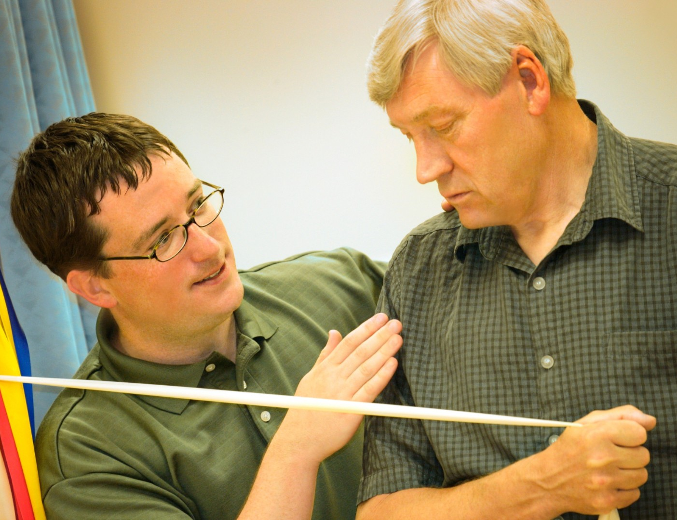
Why Are BCTs Important in Physiotherapy?
Enhance adherence and motivation
Improve self-efficacy and confidence
Reduce drop-out and relapse
Empower patients towards independence
Supported by NICE guidelines and CSP recommendations

Slide 27
How to Use BCTs in Practice (Step-by-Step)
Assess behaviour using COM-B (what’s missing?).
Select appropriate intervention functions (e.g., education, training).
Choose BCTs to address those factors.
Implement BCTs in conversations and treatment plans.
Evaluate – did the patient change their behaviour?

Slide 28

Case Study: Example in Practice
Case:
Patient with chronic knee pain avoids walking due to fear of pain.
Task for students (in pairs):
Identify COM-B factors limiting behaviour.
Choose 2–3 appropriate BCTs.
Plan how to apply them in clinical communication.
This Photo by Unknown Author is licensed under CC BY-SA

Slide 29
Capability:
poor understanding → BCT = Instruction
Motivation:
fear of pain → BCT = Reattribution, Reassurance
Opportunity:
limited time → BCT = Action planning
Example answers

Slide 30
BCT Communication Examples
“Let’s set a small, realistic goal for this week.” (Goal setting)
“Can you show me how you’ll fit this into your daily routine?” (Action planning)
“How confident are you that you can do this?” (Confidence scaling)
“What might get in the way? How could you overcome that?” (Problem solving)

Slide 31
Evidence Base
BCTs improve adherence to exercise in musculoskeletal rehab (Lonsdale et al., 2017; French et al., 2014).
Effective when physiotherapists integrate motivational interviewing, goal setting, and feedback.
NICE recommends behaviour change support for chronic pain, obesity, smoking cessation, etc.

Slide 32
Limitations and Ethical Use
Use within scope of practice (BCT-informed, not full psychological therapy).
1
Individualise approach—avoid coercion or judgment.
2
Seek supervision or refer to psychology if deeper issues emerge.
3

Slide 33

Any Question
This Photo by Unknown Author is licensed under CC BY-NC

Slide 34


Slide 35
Instructions
For each scenario:
Identify possible thoughts, feelings, behaviours, and physical reactions the patient might experience.
Suggest one or two CBT-informed physiotherapy responses, such as:
  Guided discovery
  Reassurance and education
  Goal setting
  Problem solving or action planning
  Confidence scaling
  Positive feedback
Situation | Thoughts | Feelings | Behaviours | Physiotherapy Response)

Slide 36
Scenario 1
A 46-year-old man with a history of back pain avoids bending or lifting objects, even though his physiotherapist has advised gradual return to movement.
Scenario 2
A 65-year-old woman in stroke rehab says she doesn’t see the point of therapy because she feels she’ll “never get back to normal.”
Scenario 3
A 40-year-old office worker has been given shoulder exercises but keeps forgetting to do them at home. She feels frustrated with her lack of progress.
Scenario 4
A 25-year-old football player recovering from ACL surgery says, “I’ll never be as strong or fast as before,” and is inconsistent with rehab.
Scenario 5
A 55-year-old patient with chronic knee pain stops walking for exercise because they believe activity will make their condition worse.

Slide 37
Design the Intervention
Coose one scenario
Task
Identify the main COM-B barrier(s) (Capability, Opportunity, Motivation).
Choose 3-4 suitable BCTs from the handout.
Design a short physiotherapy-based intervention plan using those techniques.
Prepare to explain their reasoning to the class.

Slide 38
Scenario 1
John is a 46-year-old warehouse worker recovering from a lumbar strain he sustained six months ago. Although his pain has reduced and he has regained good mobility, John remains very cautious about moving. He avoids bending, lifting, and even doing basic house chores because he believes any wrong movement could “damage his back again.” His wife now does most of the physical work at home, and John feels guilty and frustrated but insists he is “being careful.” He reports stiffness and constant tension in his lower back from keeping it rigid. As the physiotherapist, you need to explore his beliefs and help him understand the difference between pain and harm. Your goal is to encourage graded movement, rebuild his confidence, and help him re-engage in normal daily activity.

Slide 39
Scenario 2
Mary is a 67-year-old retired teacher who experienced a mild stroke 10 weeks ago, leaving her with weakness in her left arm and leg. She attends physiotherapy sessions regularly but puts in minimal effort and shows little interest in her exercises. Mary often says, “I’ll never get back to normal, so what’s the point?” She lives alone, has few visitors, and seems to have lost confidence in her ability to recover. During therapy she appears withdrawn and tired, doing only the minimum required. As the physiotherapist, your challenge is to explore her thoughts and feelings, identify what matters most to her, and help her rediscover motivation through positive feedback, small achievable goals, and active involvement in planning her rehabilitation.

Slide 40
Scenario 3
Aisha is a 39-year-old office worker being treated for shoulder impingement. She has attended three physiotherapy sessions and understands her home exercise programme but rarely completes it. When asked, she says she “forgets most days” or feels “too tired after work.” She expresses frustration about her lack of progress, commenting that “these exercises don’t seem to make much difference anyway.” Aisha juggles a demanding job and family responsibilities, often putting her own needs last. As her physiotherapist, you need to explore her barriers, identify what is realistic for her schedule, and help her develop a simple, sustainable plan that fits her lifestyle. The focus is on improving adherence through collaborative goal setting and problem solving.

Slide 41
References & Further Reading
Michie S. et al. (2011). The Behaviour Change Wheel. Implementation Science.
Michie S. et al. (2013). The Behaviour Change Technique Taxonomy (v1).
French D.P. et al. (2014). Physiotherapists’ use of behaviour change techniques in practice.
NICE (2021). Behaviour change: general approaches.
Beck, A. T. (1976). Cognitive Therapy and the Emotional Disorders.
NICE (2021). Chronic pain (primary and secondary) in over 16s: assessment of all chronic pain and management of chronic primary pain.
Turk & Gatchel (2018). Psychological Approaches to Pain Management.

